Slide 1
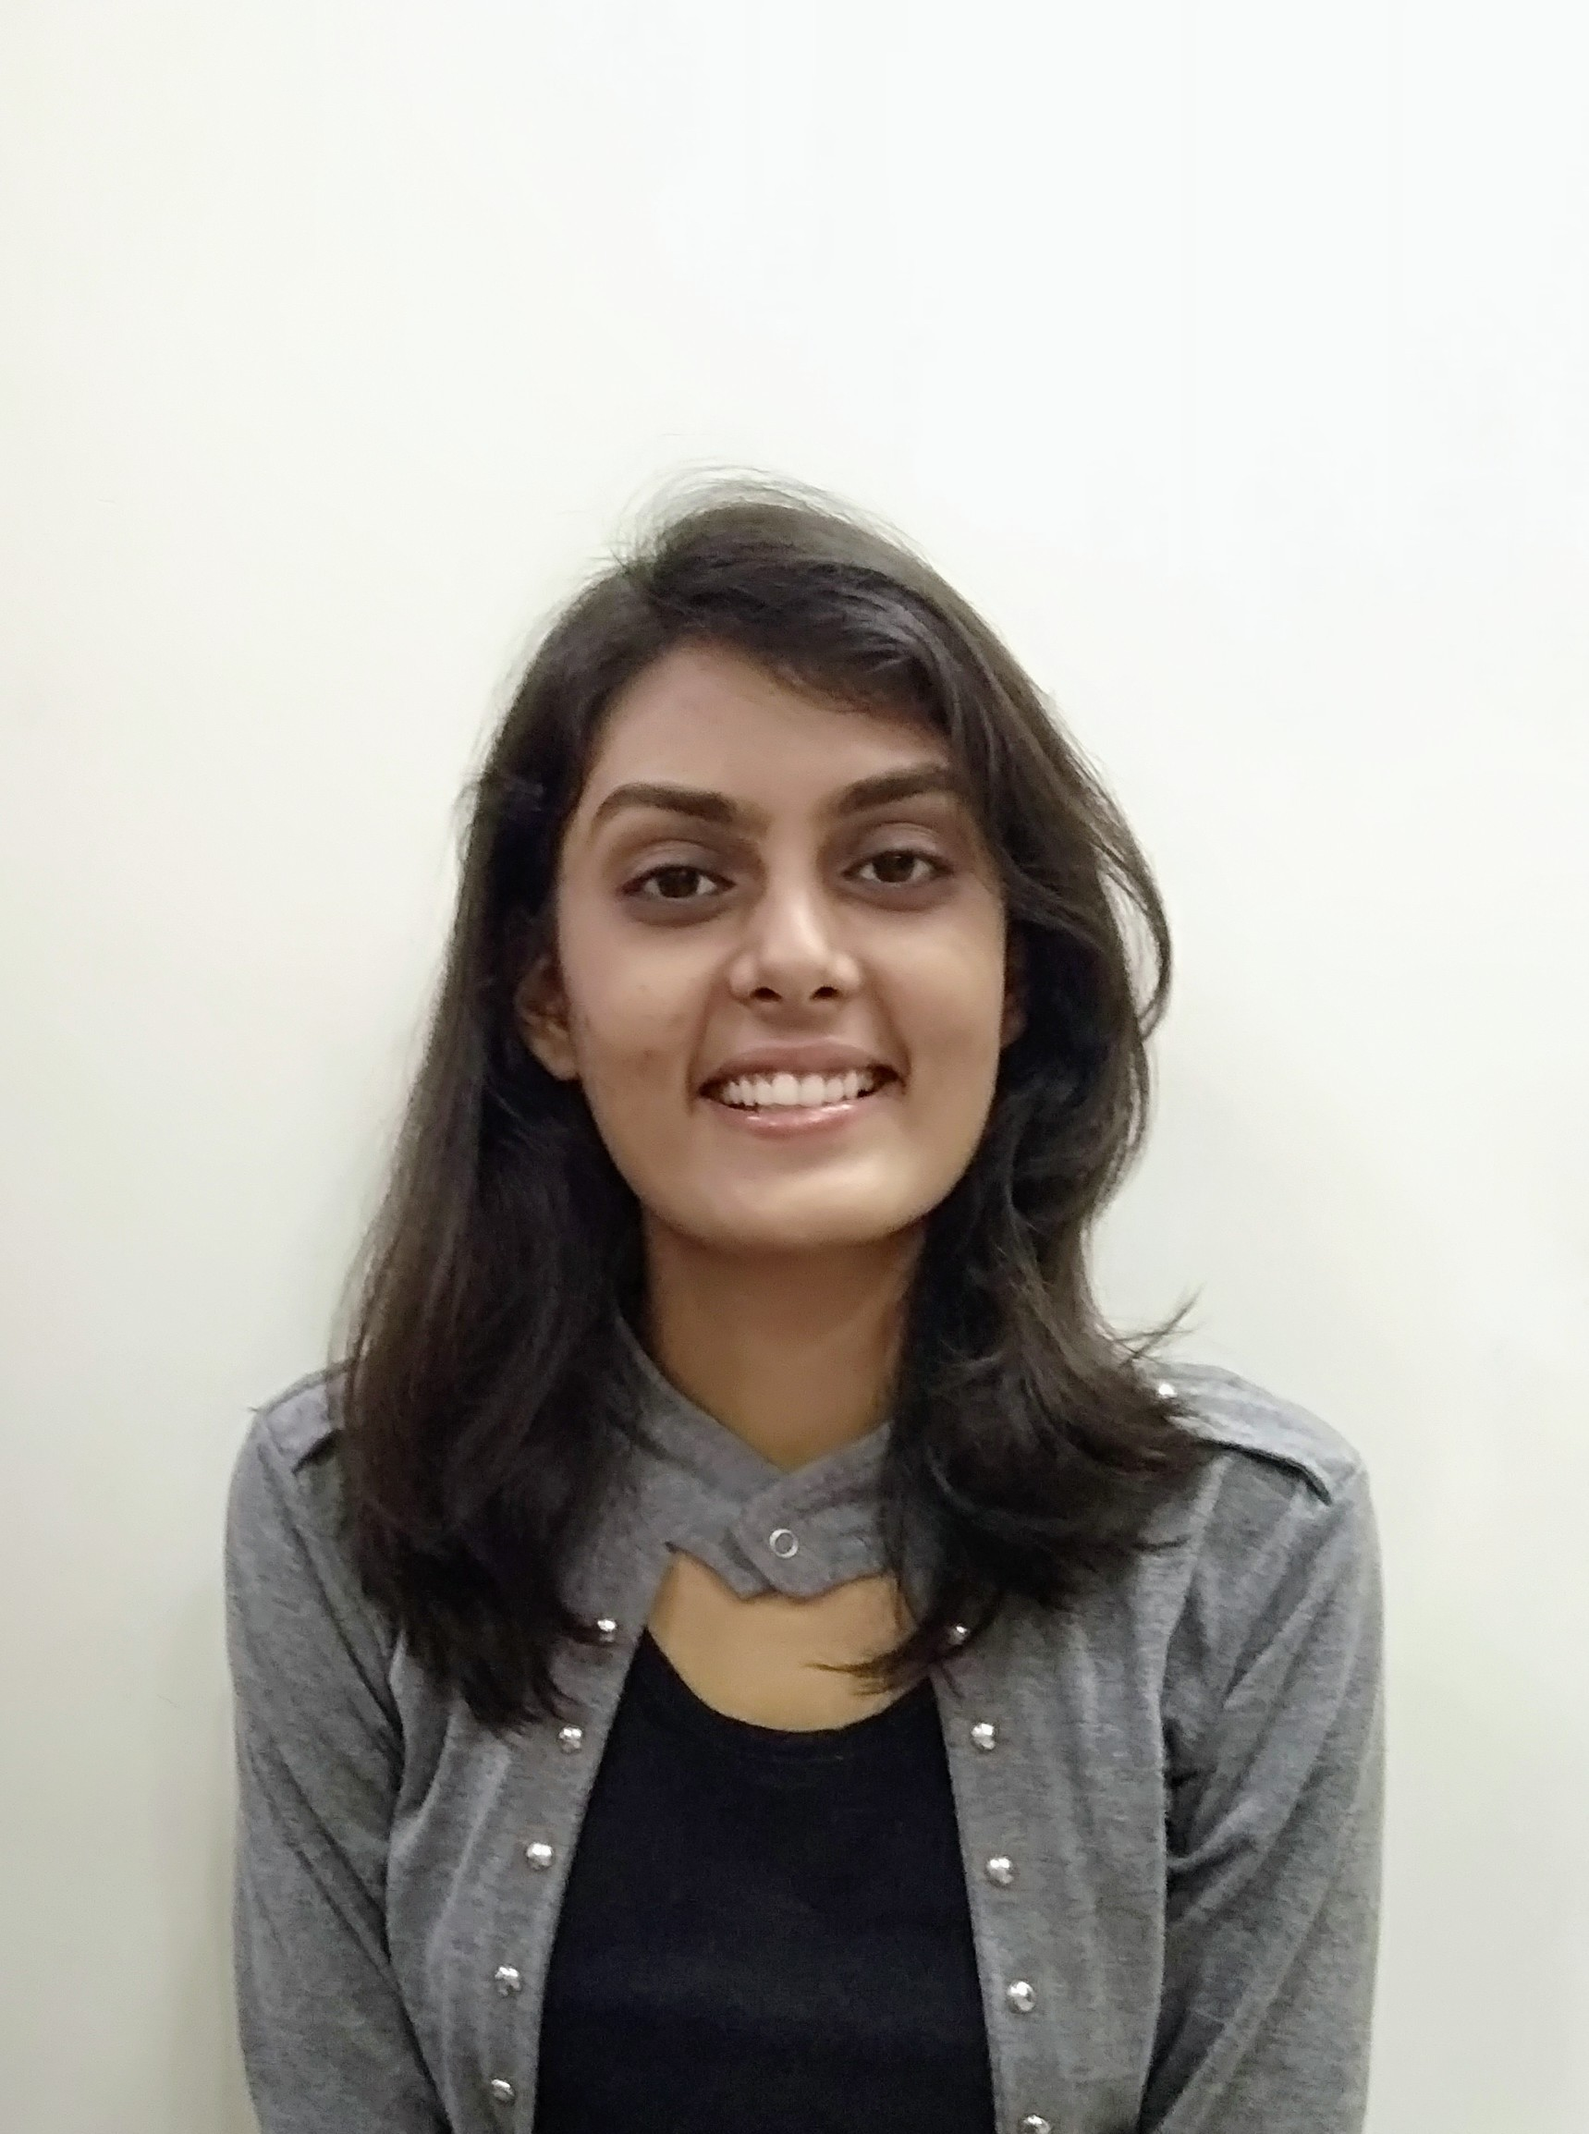

ANUSHKA RAMESH KALE
Sr. Analyst/Software Engineer
Bachelor of Engineering (Computer Science & Engineering) : 2016 - 2020
SKILLS
Java 8 /J2EE
Spring Boot
JPA CRUD
React
AWS
Jenkins
Database
SQL database–PostgreSQL, MySQL, H2
Web Tools
HTML5
CSS3
Javascript (Basics)
Bootstrap
AddOns
Eclipse
Spring Tool Suite
GitHub
Postman
Swagger
Additional Details
Excellent Communication Skills
Flexible & Adaptive
Quick Learner
Team Management
Mumbai Emp Id: 46051571 Emp Id: 46051571
anushka.kale@capgemini.com
+91 9834938517
A5
•Software Engineer who is Strong in problem-solving and logic building skills. Passionate about implementing and launching new projects.
•Ready to learn new technologies and implement them to further improve my knowledge.
•Eager to work in a team of dedicated people and serve a key role in the enhancement and development of the project.
•Has working knowledge on Core Java and React concepts along with Microservice Development using Spring framework on an intermediate level.
DevSecOps Acceleration Platform
DevSecOps Acceleration platform which gives unified view of quality tollgates across application portfolio. Worked on Devops tools like Jenkins AWS in this project.
Flight Booking System Application
Developed Flight Booking System Application using Spring Boot framework including Microservices, Spring Security, Spring Cloud & JUnit Test Cases with PostgreSQL, H2, MySQL as database in agile methodology of software development model.
Presentation Link:
https://capgemini-my.sharepoint.com/:v:/r/personal/amit_mahadik_capgemini_com/Documents/Capgemini/Data/Anushka%20Kale-Flight_Management_System.mp4?csf=1&web=1&e=54fFD6
Credit Card System Application
Completed end to end case study of Credit Card System Application using Spring Boot framework and React with PostgreSQL as database in agile methodology of software development model.

